Slide 1
TRACE REQUIREMENTS AND DESIGNS - INSIGHT by Sakina Haque

Slide 2

Why Trace Requirements and Designs?
Traceability helps manage scope by connecting requirements and designs to the business need and making sure the implemented solution conforms to requirements.
It also assists in identifying missing functionality (coverage) and conversely rogue requirements that don’t map to a business need.

Slide 3

Why Trace Requirements and Designs?
In the simplest form, traceability can be achieved by linking each Business Requirement to the Solution Requirement(s) that satisfy(ies) it.
Inter-relationships are important to demonstrate the impact analysis of changes to requirements e.g. if a parent requirement is no longer required, then all child requirements should also be no longer required, and for prioritisation of requirements.

Slide 4

Why Trace Requirements and Designs?
Effective tracing of requirements and designs establishes a scope baseline for mapping test cases, which helps identify testing gaps.
Traceability is crucial during audits, as auditors typically examine adherence to plans, processes, and budgets.
A well-documented traceability matrix can demonstrate that each requirement aligns with the high-level vision and that solution components are developed solely to meet these requirements.

Slide 5



How Can Requirements and Designs Be Traced?
Make sure each requirement has a unique identifier.
A business requirement can have a different prefix to a functional requirement to easily identify the level of requirement it belongs to. A numbering system could also be developed to identify the group or category of the requirement. For example, BR.SM.001 for a Sales & Marketing business requirement and FR.FIN.001 for a Finance functional requirement.
Record any relationships or dependencies between requirements.
This will assist in planning the order of analysing and developing a solution e.g. if a parent requirement is being developed, all child requirements should also be developed.
Ensure all requirements have the necessary approval.
The starting point is a baseline of scope.

Slide 6


How Can Requirements and Designs Be Traced?
Perform an assessment for any suggested change.
Determine which requirements will be affected by the change.
Any related requirements may also need to change. This should be identified and subject to the standard change management process adopted by the organisation.
Use the appropriate tools to manage traceability.
There are many online tools and software applications designed to manage traceability that can track changes and generate Coverage reports to provide insight into upstream and downstream requirement relationships.
Where there are more than 100 requirements, consider using an application to trace requirements and designs rather than a manual method such as a spreadsheet.

Slide 7


Traceability Models
Agile Initiative
Waterfall Initiative
Business Driver
Business Case
Business Requirements
Business Driver
Business Case
Business Requirements Document
Business Requirements
Product Manager, SMEs, Product Owner and/ or Business Analysis Professional
High Level Requirements
Sponsor, SMEs & Project Manager and/ or Business Analysis Professional
Epic
Business Rules
Stakeholder Requirements
Solution Requirements
Test Case & Scripts
Test Results
Business Process Document
Functional Specification
Feature
Business Requirements
User Story
Solution Requirements
Business Analysis Professional
Solution Architect
End to End Traceability
End to End Traceability
Acceptance Criteria
Scrum Team/ Development Team (includes Business Analysis Professional)
Designs
Test Case
Test Case
Test Plan
Test Case & Scripts
Test Results
Defect
Defect
Test Manager/ Lead
& Testers

Slide 8
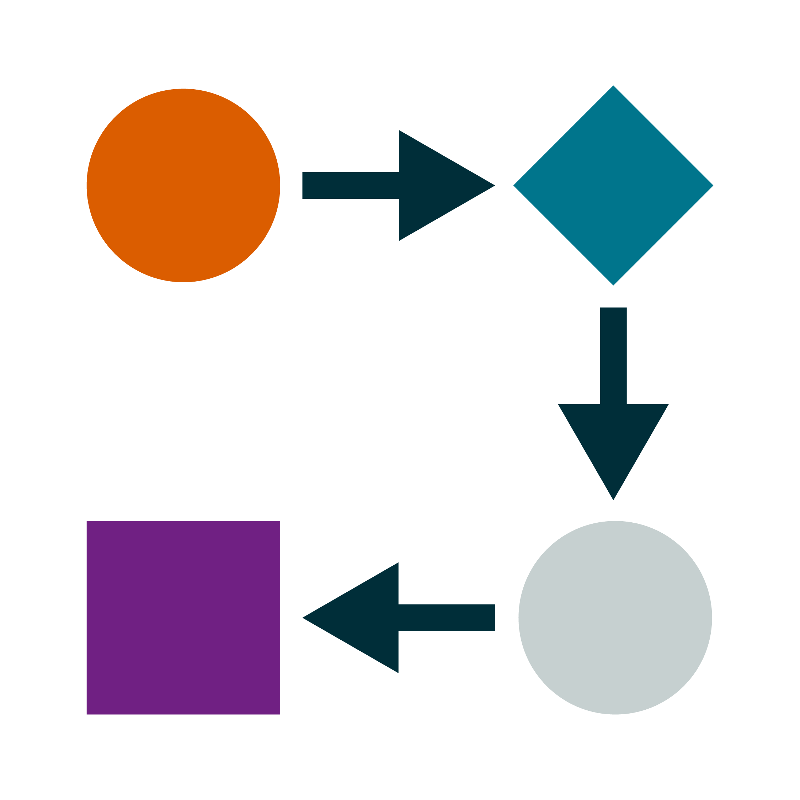


How to Decide on What Information Should Be Traced
The Approach
Consider the approach being taken for the initiative. Will it follow an adaptive (Agile) approach?
The Complexity
Try to avoid creating additional levels of requirements and designs from what the initiative already has, simply to fill out the model. The items being traced should provide a benefit to the model as maintenance can become difficult or result in errors when changes begin to take place.
The Origin
Capturing the provenance of each requirement will help to identify the owner should a change affect their requirement due to a dependency or other relationship.

Slide 9

How to Choose the Most Suitable Techniques
A Coverage report will examine how many of the requirements have been covered by test cases. It will expose any gaps in testing and ensure that effort is focused on testing the scope defined.

Slide 10

How to Choose the Most Suitable Techniques
Functional Decomposition is a technique for breaking work down into manageable pieces.
In the context of tracing requirements and designs it can be used to expand Business Goals into Business Requirements, Business Requirements into Solution Requirements or Epics into Features and User Stories.
A tool called a Work Breakdown Structure has been provided in the following slides.

Slide 11

How to Choose the Most Suitable Techniques
A Requirements Traceability Matrix will demonstrate forward traceability by verifying that requirements correspond to designs and solution components. Reverse traceability will confirm that the solution will deliver the business needs and objectives of the initiative.

Slide 12

How to Choose the Most Suitable Techniques
Use cases and Extensions are a way of modelling requirements and showing the relationships between them.
If not using Use Cases to document requirements, try linking requirement statements using a parent/ child identifier.

Slide 13
Work Breakdown Structure (WBS) Template

Slide 14
How to Use the Template
01
Identify the high-level subject areas in the initiative being defined. Ensure that as a collection they describe the initiative completely. These will be the Epics populated in the top row of the template. Double click the template to edit each shape in the diagram.
Break each Epic down into smaller chunks to determine the Features. These will be populated in the next level of the diagram. Each Epic now has a dependency on all its Features being developed before it can be considered ‘Done’.
Break each Feature down into individual requirements. These can include software enhancements, process improvements, introduction of new capability and integration tasks etc. These will be populated in the next level of the diagram as User Stories. Each Feature now has a dependency on all its User Stories being developed before it can be considered ‘Done’.
02
03

Slide 15
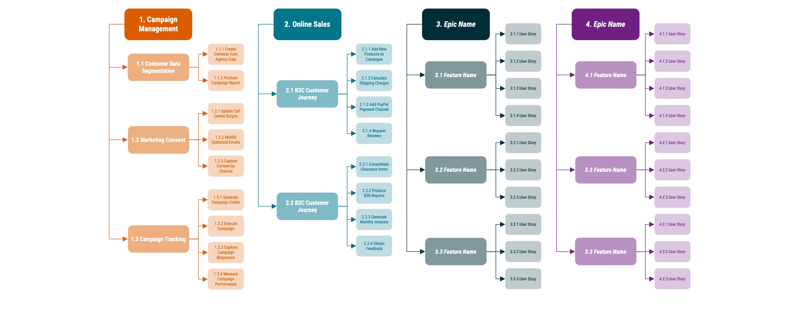
Click the Example to Access the Editable Template

