Slide 1
Prioritize Requirements and Designs - Insight by Sakina Haque

Slide 2

Why to prioritize requirements and designs?
Most initiatives do not have unlimited resources such as budget, people and time to deliver every single requirement put forward by a stakeholder.
Equally, a stakeholder wouldn't want to wait for the entire set of requirements to be delivered before they start receiving value from the end product.

Slide 3

Why to prioritize requirements and designs?
Prioritizing requirements and designs will allow the most important requirements to be delivered first so they can begin to add value and the organisation can begin to realise the benefits of the change as early as possible.
There may also be situations in which different stakeholders raise contradictory requirements, so it is necessary to understand the importance of each requirement as seen by the various stakeholders involved and the dependencies between them.

Slide 4






How Can Requirements and Designs Be Prioritized?
Each requirement or design needs to be:
Captured
in a consistent format
Understood
in terms of what it is trying to achieve, the value it will bring and any dependencies it may have
Assigned
an owner which may be the stakeholder who raised it – this will be the person responsible for championing its priority
Sorted
into groups or themes to make them easier to score against prioritization criteria
Then the requirements and designs are ready for prioritisation by the stakeholders.

Slide 5

How to Decide on Prioritization Criteria
This will be dependent on the change being proposed and the business objectives.
Performing analysis will help to understand what the stakeholders are driven by, the product lifecycle stage and the importance of delivering the change and its benefits.

Slide 6

How to Decide on Prioritization Criteria
There are many factors that an organisation will need to consider in their chosen prioritization approach. Here are a few examples:
Financial implications
such as penalties or fines imposed because of breaches or an increase or decrease in revenue
Technical complexity that creates risk
to delivery
Customer value created such as improvements to the customer journey
Competitive advantage and/ or innovation

Slide 7

How to Decide on Prioritization Criteria
There are many factors that an organisation will need to consider in their chosen prioritization approach. Here are a few examples:
Risk associated
with lack of controls or of not having a feature, product or process in place
Regulatory requirements
Operational ease
by creating efficiencies through process or technology changes. For example, enhancing functionality of a system to eliminate the need for an employee to complete tasks manually or integrating systems to avoid double keying of data.

Slide 8

How to Decide on Prioritization Criteria
Using a cost vs. benefit lens when selecting prioritization criteria will provide a more balanced view of the requirements.
Otherwise, the model will be unfairly slanted towards one side which can result in poor outcomes.

Slide 9
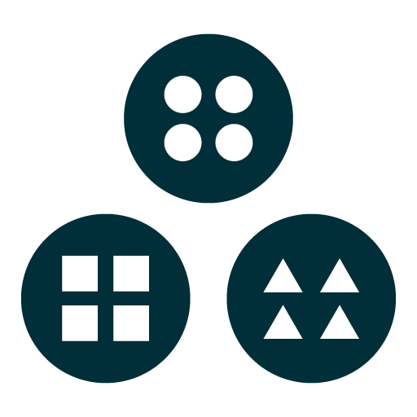



Prioritisation Approaches
The approach taken to prioritise requirements and designs may vary depending on the group of stakeholders involved and their needs. It may also change as certain conditions change, such as the product lifecycle stage, outside market or personnel changes.
Prioritisation can be classified into one of four approaches:
Grouping
Ranking
Timeboxing/Budgeting
Negotiation
Define groups based on themes or categories.
Assign each requirement or design to a group.
Evaluate each requirement or design against criteria.
Order each requirement from most to least important.
Determine the amount of fixed resource available (time or money).
Allocate a proportion of that fixed resource to each requirement or design.
Include all stakeholders to achieve a common understanding of the requirements and designs.
Facilitate consensus on priority.

Slide 10
How to Choose the Most Suitable Techniques
If there are clear objectives of the change:
Each requirement or design can be assessed against the objectives, so a simple system of High, Medium and Low can be used.
H(igh)
M(edium)
L(ow)
The requirement is directly tied to the objectives
The requirement is indirectly tied to the objectives
The requirement does not relate to the objectives
Grouping

Slide 11
How to Choose the Most Suitable Techniques
If there are a concise number of requirements or designs and a few stakeholders or multiple stakeholders from a single department:
It may be possible to see some themes emerging from the requirements or they naturally fall into a few buckets. The MoSCoW prioritisation technique can be used.
Must Have
A mandatory requirement because without it the solution wouldn’t be viable or meet a particular standard.
Should Have
The requirement is significant to the solution but would still provide value and function without it.
Could Have
A ‘nice to have’ requirement that will provide a more polished solution.
Won’t Have
A requirement that has been ruled out due to time, cost, being contradictory to other requirements, etc.
Grouping

Slide 12

How to Choose the Most Suitable Techniques
If there are many requirements or designs and many stakeholders across multiple departments:
There is a risk of competing requirements which are all mandatory to deliver. There needs to be a way to highlight the priority of one requirement over another, so a scorecard may be the best approach.
Negotiation
Ranking

Slide 13
Scorecard Template

Slide 14
How to Use the Template
01
Identify the Prioritisation Factors that apply to the set of requirements and designs you will be prioritising. As a guide, selecting between 3-5 Prioritisation Factors will keep the model simple.
Assign a weighting to each Prioritisation Factor to indicate the importance of this factor relative to the others. The sum of your weightings should be 100%. For example, if the main objective of the change is to deliver a new product to market your factors and weightings may be Strategy 40%, Revenue 30%, Cost 10% and Risk 20%.
Give each requirement or design a score out of 10 for how well it aligns with each of the Prioritisation Factors, where 0 means the requirement or design does not align with the Prioritisation Factor and 10 means the requirement or design is fully aligned
Calculate the score for each requirement and design by applying the SUMPRODUCT function in Excel to multiply the score for each Prioritisation Factor by its weighting and add the results together.
Rank each requirement and design against each other based on the calculated score. The highest score will be Priority 1, the next highest score will be Priority 2, and so on.
02
03
04
05

Slide 15
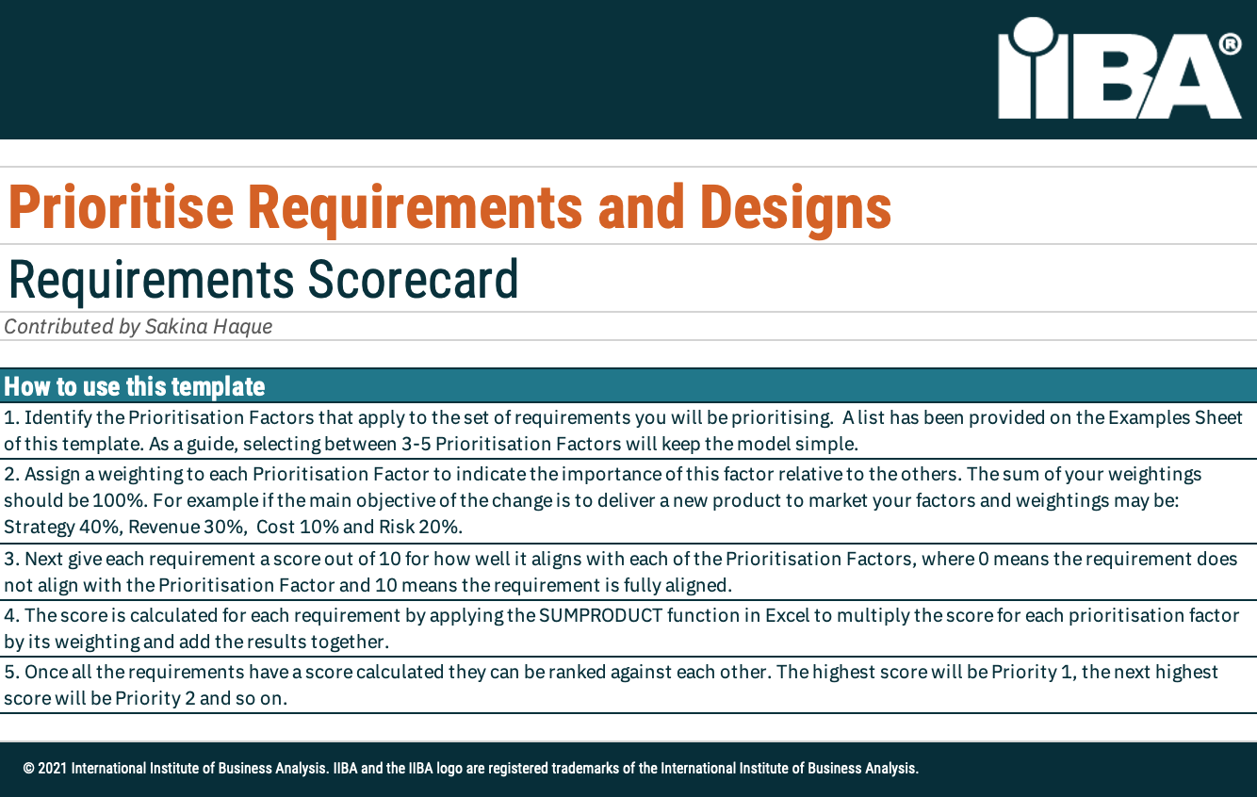
Click to Access the Editable Scorecard Template

Slide 16
List of Possible Prioritisation Criteria
Cost Prioritisation Factors | Benefit Prioritisation Factors
Operational cost | Competitive advantage
Implementation effort | Innovation
Financial penalty | Operational ease
Technical complexity | Customer value
Regulatory requirement | Strategy alignment
Compliance requirement | Increase revenue
Risk associated with lack of controls or exposure | Increase adoption
 | Increase transactions
 | Brand awareness
 | Lead generation

Slide 17
Example
The initiative, feature or set of requirements will be evaluated against the factors which are most important to the organisation at the present time. The prioritisation factors represent a balanced view of cost versus benefit.
 |  |  | Prioritisation Factors
Req. ID | Req. Name | Req. Owner | Effort to Deliver | Penalties | Customer Value | Strategy | Operational Ease | Score | Priority
 |  |  | 15% | 30% | 20% | 10% | 25%
AD-019 | Auto display Customer Name and Account when call received | Sam Saturn | 6 | 0 | 8 | 7 | 10 | 5.7 | 1
CO-008 | Capture Marketing Consent for email campaigns | Anthea Goodman | 2 | 6 | 4 | 5 | 6 | 4.9 | 3
AD-022 | Prompt Agent to communicate privacy policy for first time callers | Sam Saturn | 3 | 9 | 5 | 4 | 2 | 5.05 | 2
The weighting determines the proportion of points that contribute to the overall score for each requirement.
The requirement score is calculated as the SUMPRODUCT of points and weightings.
The highest scoring requirement will be Priority 1
Points for each prioritisation factor are allocated to each requirement out of a possible 10 points, where 10 indicates the requirement is fully aligned to the prioritisation factor.

Slide 18
Some Closing Thoughts
Raw scores may need to be adjusted to cater for interdependencies of requirements and designs, e.g. a lower priority requirement may need to be elevated if a higher priority requirement depends on it.
Business Analysis Professionals will perform the analysis that will inform them on selecting the best approach, techniques and prioritisation criteria for the change. When it comes to deciding on priorities, they will facilitate the stakeholders to make the decisions.

